Slide 1

HRI interface comparisons (VR, AR, bio-signal-based) Sebastian Hirt

Slide 2
Agenda
01
Why compare?
02
General Comparison in different Categories
03
Specific examples for VR
04
Specific examples for AR
05
Specific examples for bio-signal-based
06
What is the best path forward?

Slide 3
Why compare?
Introduction
Dictate direction of future research
Best option for current use in industry

Slide 4
Agenda
01
Why compare?
02
General Comparison on different Categories
03
Specific examples for VR
04
Specific examples for AR
05
Specific examples for bio-signal-based
06
What is the best path forward?

Slide 5
Use Cases
Agenda
Use cases
VR
Control motion of robot over internet
AR
Display important robot information (range of motion/wear and tear)
Bio-signal-based
Give swift feedback to robot

Slide 6
Devices
General comparison
Devices
VR
VR-Headset (Oculus Rift, HTC Vive, Meta quest pro)
AR
Tablet, Smartphone, AR-Glasses (Google glasses)
Bio-signal-based
Implants, Wearables

Slide 7
Cost
General comparison
Cost
VR
Expensive Headsets (gets cheaper through gaming)
AR
Cheap, no special devices necessary (most of the time)
Bio-signal-based
Can be cheap on low end, and very expensive on high end

Slide 8
Ease of use
General comparison
Ease of use
VR
Uncomfortable for long periods of time
AR
Really simple
Bio-signal-based
Easy for wearables, permanent augment for implants

Slide 9
Intuition
General comparison
Intuition
VR
Ego perspective and controller in hands → high intuitivity
AR
A bit better than controlling from computer, but way worse than VR
Bio-signal-based
Wearables: can be good depending on implementation (move arm muscles to move robot arm)
Implants/EEG: highest possible Intuition, just think of what the robot should do

Slide 10
Future Potential
General comparison
Future Potential
VR
Good for taking over control of “almost fully” autonomous systems remotely
Form factor needs to be improved
AR
Integration into traditional glasses or even contact lenses
Bio-signal-based
Implants/EEG: huge potential to merge with robots and full control of a robot with a human's thoughts

Slide 11
Agenda
Agenda
01
Why compare?
02
General Comparison in different Categories
03
Specific examples for VR
04
Specific examples for AR
05
Specific examples for bio-signal-based
06
What is the best path forward?

Slide 12
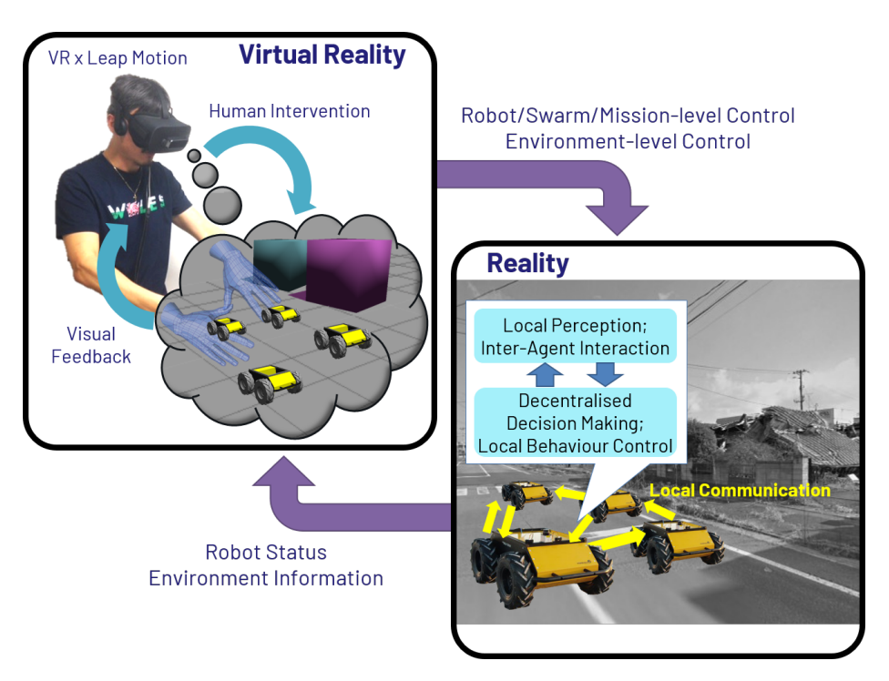
Specific Example for VR
Omnipotent Virtual Giant for Remote Human–Swarm Interaction
Control over swarm of robots like a swarm of ants
Placing virtual objects in path of robot via environmental manipulation
Teleoperation possible
Intuitive and feasible but might need training
Large amounts of robots might increase latency and inhibit intuitivity
(Jang et al., 2021)

Slide 13
Agenda
Agenda
01
Why compare?
02
General Comparison in different Categories
03
Specific examples for VR
04
Specific examples for AR
05
Specific examples for bio-signal-based
06
What is the best path forward?

Slide 14
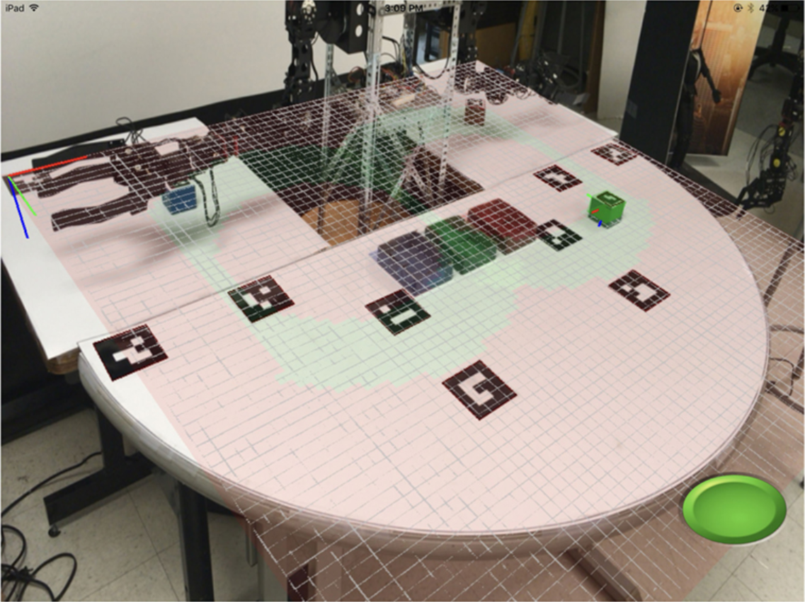
Specific Example for AR
Mobile Mixed-Reality Interfaces That Enhance Human–Robot Interaction in Shared Spaces
Visualization of information about robot in shared space
Pointing Tablet at workspace
Showing range of motion of robot
Pre render potential future moves of the robot
(Frank et al., 2021)

Slide 15
Agenda
Agenda
01
Why compare?
02
General Comparison in different Categories
03
Specific examples for VR
04
Specific examples for AR
05
Specific examples for bio-signal-based
06
What is the best path forward?

Slide 16
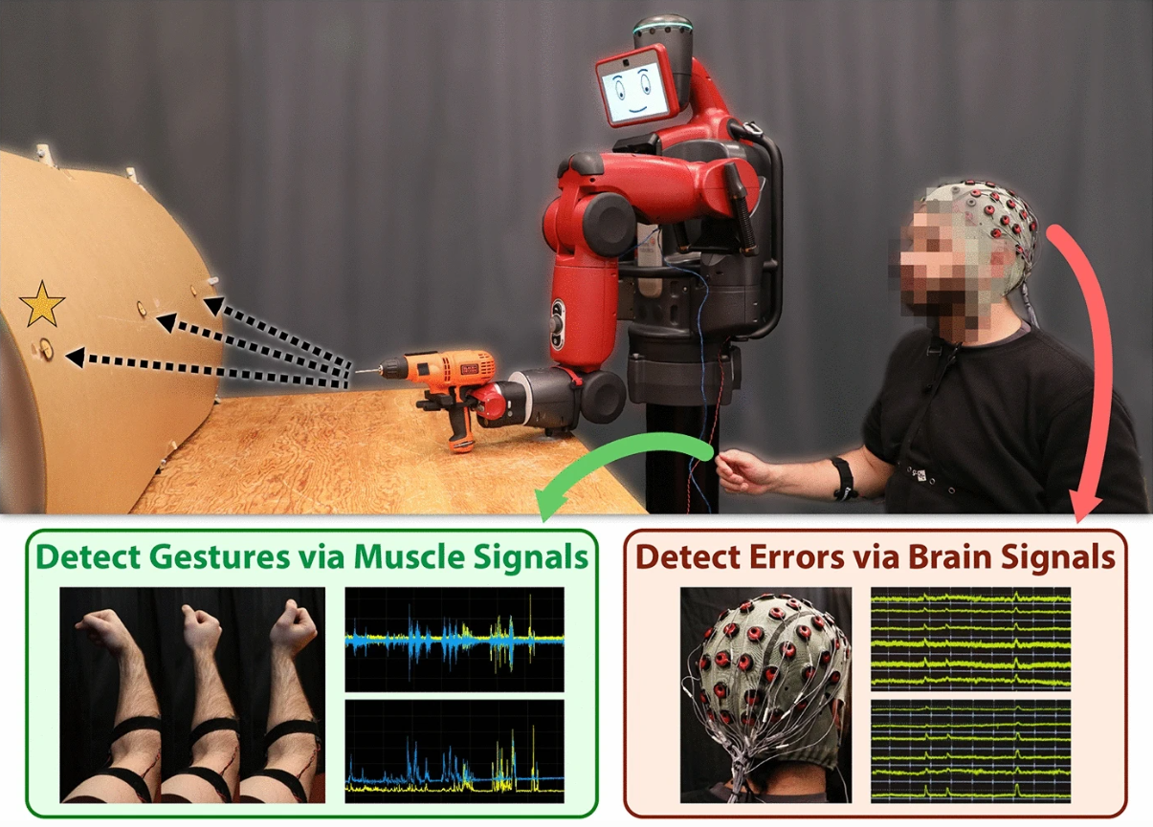
Specific Example for bio-signal-based
Plug-and-play supervisory control using muscle and brain signals for real-time gesture and error detection
Classification of left and right hand gestures via muscle signals (EMG)
Error recognition through brain function (EEG)
Combination in hybrid system
Tested on 7 subjects (Plug and Play) to reduce barrier of entry for new users
Shows potential, but more training data needed
(DelPreto et al., 2020)

Slide 17
Agenda
Agenda
01
Why compare?
02
General Comparison on different Categories
03
Specific examples for VR
04
Specific examples for AR
05
Specific examples for bio-signal-based
06
What is the best path forward?

Slide 18
Best path forward
Best path forward
End goal:
Bio-based, control robots with human thoughts
Intermediate steps
Depending on how fast EEG Implants develop
AR seems like a nice cheap solution for a variety of problems
VR only for special problems useful (when intuition necessary, remote work)

Slide 19
Literature
Whitney, D., Rosen, E., Ullman, D., Phillips, E., & Tellex, S. (2018). ROS Reality: A Virtual Reality Framework Using Consumer-Grade Hardware for ROS-Enabled Robots. 2018 IEEE/RSJ International Conference on Intelligent Robots and Systems (IROS), 1–9. doi:10.1109/IROS.2018.8593513
Jang, I., Hu, J., Arvin, F., Carrasco, J., & Lennox, B. (2021). Omnipotent Virtual Giant for Remote Human--Swarm Interaction. 2021 30th IEEE International Conference on Robot & Human Interactive Communication (RO-MAN), 488–494. IEEE.
Frank, J. A., Moorhead, M., & Kapila, V. (2017). Mobile mixed-reality interfaces that enhance human--robot interaction in shared spaces. Frontiers in Robotics and AI, 4, 20.
DelPreto, J., Salazar-Gomez, A. F., Gil, S., Hasani, R., Guenther, F. H., & Rus, D. (2020). Plug-and-play supervisory control using muscle and brain signals for real-time gesture and error detection. Autonomous Robots, 44(7), 1303–1322.
Musk, E., & Others. (2019). An integrated brain-machine interface platform with thousands of channels. Journal of medical Internet research, 21(10), e16194.
Lipton, J. I., Fay, A. J., & Rus, D. (2017). Baxter’s homunculus: Virtual reality spaces for teleoperation in manufacturing. IEEE Robotics and Automation Letters, 3(1), 179–186.
Notes:
*Please remove the parenthesis in the final version!!

